Slide 1
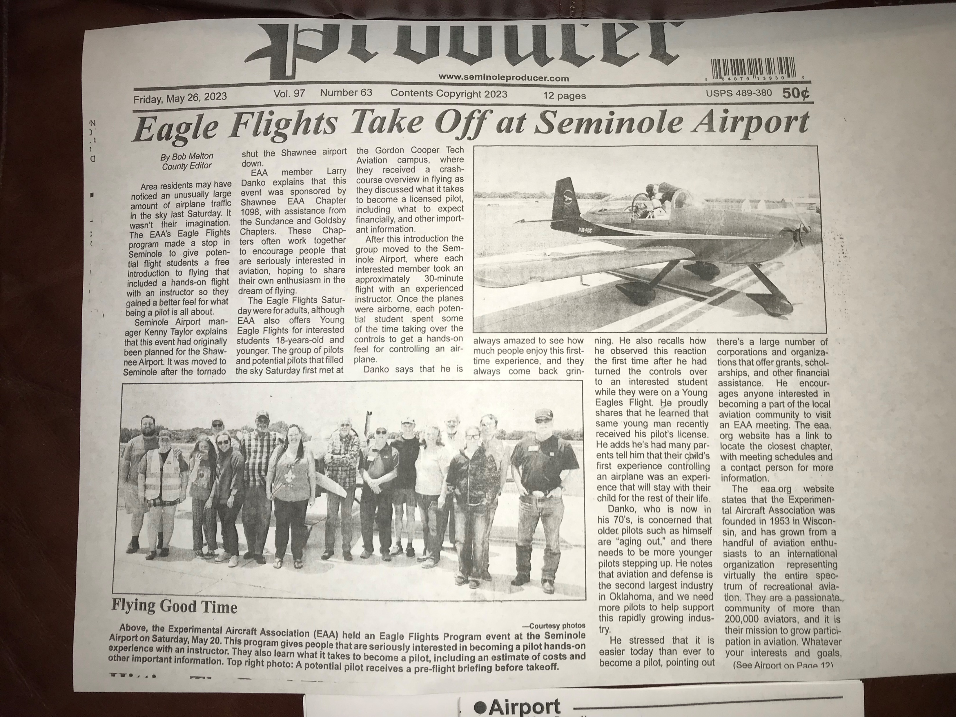
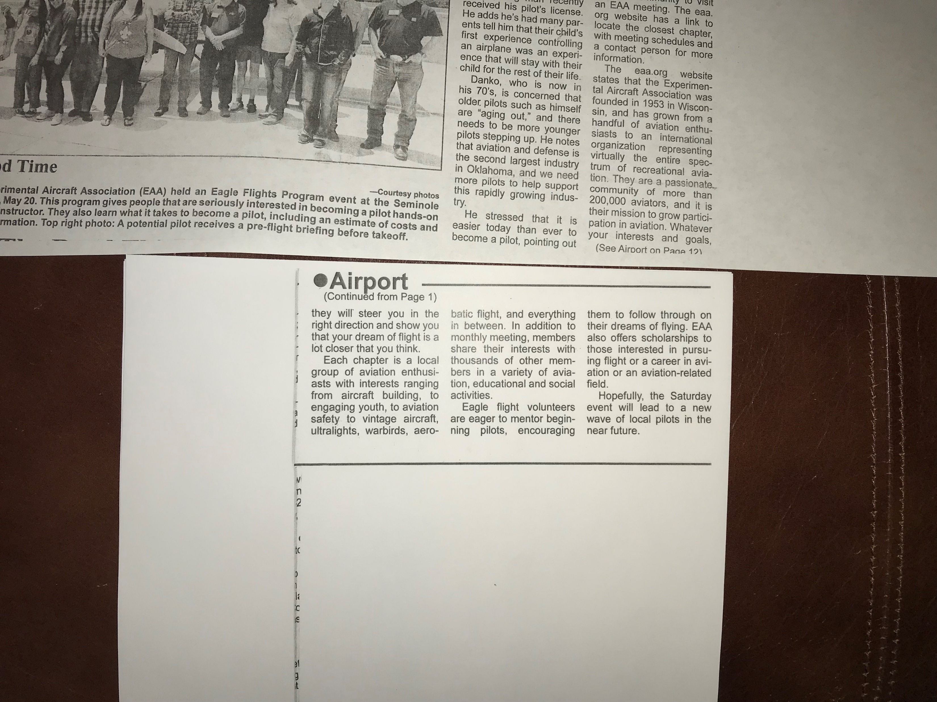
Newspaper article on Flying Start program sponsored by Chapter 1098 on Mar 20, 2023

