Slide 1



EAA 1031
IMC Club Presentation
Feb 23, 2023

Slide 2
Meeting agenda
Introduction & Question of the Month
IMC Club February Video Discussion
Visual Approaches – Brief Discussion

Slide 3
February 2023 imc question of the month
Answer: A contact approach can only be authorized when requested by the pilot, and under the conditions that (1) the pilot remain clear of clouds, (2) the reported ground visibility is at least 1 statute mile, and (3) the pilot has a reasonable expectation of continuing to the destination airport in those conditions.
Reference: FAA-H-8083-16B, glossary
Question: Under what conditions can a pilot deviate from an instrument approach procedure to complete an approach and landing under IFR conditions (Contact Approach)?

Slide 4

EAA IMC Club Video
February Topic
“Can you hear me now?”

Slide 5
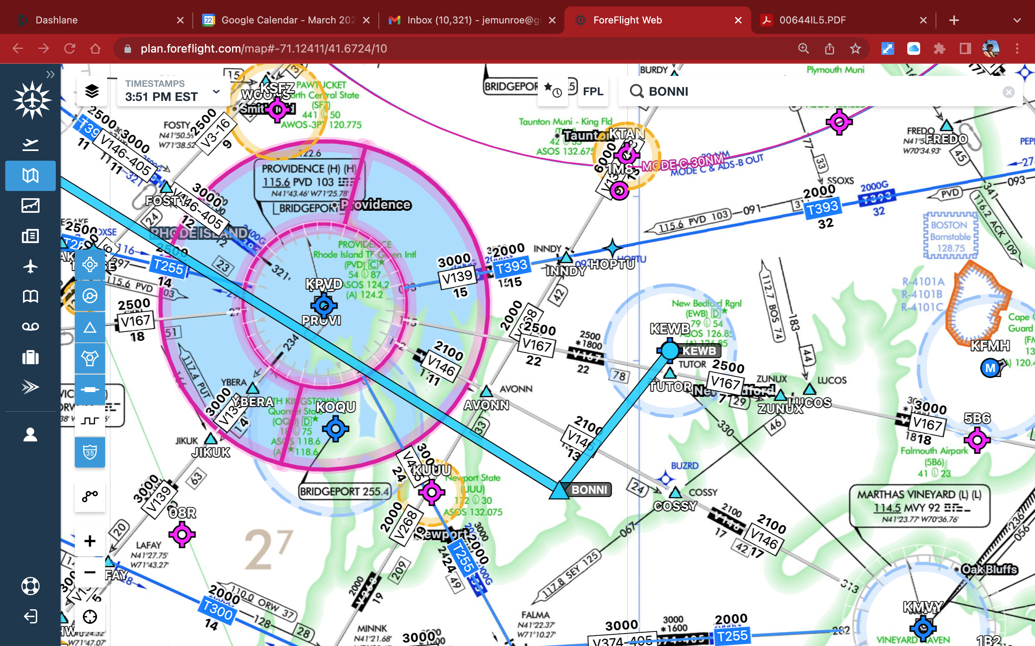

Slide 6
ILS RWY 5 APPROACH – NEW BEDFORD

Slide 7
VISUAL APPROACHES - REVIEW

Slide 8
INTRODUCTION
  Visual approaches are an IFR procedure conducted under IFR in visual meteorological conditions and clear of clouds to the airport
  Visual approaches reduce pilot/controller workload and expedite traffic by shortening flight paths to the airport
  It is the pilot's responsibility to advise ATC as soon as possible if a visual approach is not desired

Slide 9
VISUAL APPROACH CONDITIONS
Advise ATC if you can no longer maintain the following requirements:
  The airport or preceding aircraft in sight
    If the preceding aircraft is not in sight, the controller is responsible for aircraft separation
  Authorized under the control of the appropriate traffic control facility
    ATC may authorize this type of approach when operationally beneficial
    Can be requested by the pilot, or rejected in favor of a full IAP
    Pilot assumes traffic separation & obstruction clearance when proceeding visually
  Reported weather at the airport must be a ceiling at or above 1,000' and visibility at 3 SM or greater (VMC)
    Cloud clearance requirements of 14 CFR 91.155 are not applicable unless required by operation specifications
  When conducting visual approaches, pilots are encouraged to use other available navigational aids to assist in positive lateral and vertical alignment with the runway

Slide 10
A visual approach is not an IAP and therefore has no missed approach segment
  If a go-around is necessary for any reason, aircraft operating at controlled airports will be issued an appropriate advisory clearance/instruction by the tower
  At uncontrolled airports, aircraft are expected to remain clear of clouds and complete a landing as soon as possible
  If a landing cannot be accomplished, the aircraft is expected to remain clear of clouds and contact ATC as soon as possible for further clearance
  Separation from other IFR aircraft will be maintained under these circumstances
Authorization to conduct a visual approach is an IFR authorization and does not alter IFR flight plan cancellation responsibility see AIM, Canceling IFR Flight Plan, Paragraph 5-1-15
Radar service is automatically terminated, without advising the pilot, when the aircraft is instructed to change to advisory frequency
ATC Service is terminated when told to contact advisory frequency in the case of non-controlled fields

Slide 11
Operating to an Airport Without Weather Reporting Service:
  ATC will advise the pilot when weather is not available at the destination airport
  ATC may initiate a visual approach provided there is a reasonable assurance that weather at the airport is a ceiling at or above 1,000' and visibility 3 miles or greater
Operating to an Airport With an Operating Control Tower:
  Aircraft may be authorized to conduct a visual approach to one runway while other aircraft are conducting IFR or VFR approaches to another parallel, intersecting, or converging runway.

