Slide 1
EAA 1031
IMC Club Presentation
Jan 25, 2023

Slide 2
Meeting agenda
Introduction & Question of the Month
AIM, Change 3, Review
Operating In & Out of Leesburg Airport (JYO)

Slide 3
Sept 2022 imc question of the month
Answer: The MOCA (Minimum Obstruction Clearance Altitude) is the lowest published altitude between radio fixes on VOR airways, off-airway routes, or route segments at which obstacle clearance requirements for the entire route segment are met and which assures acceptable navigational signal coverage only within 25 statute (22 nautical) miles of a VOR.
The Minimum Reception Altitude (MRA) is the lowest altitude at which we can navigate the airway and also identify navigational fixes using the identified off route navaids. Note that the MOCA may be lower than the MRA, and an MRA could be higher than the minimum en route altitude (MEA).
Reference: FAA-H-8083-16B, glossary
Question: What is the difference between a MOCA and MRA on a VOR federal airway?

Slide 4
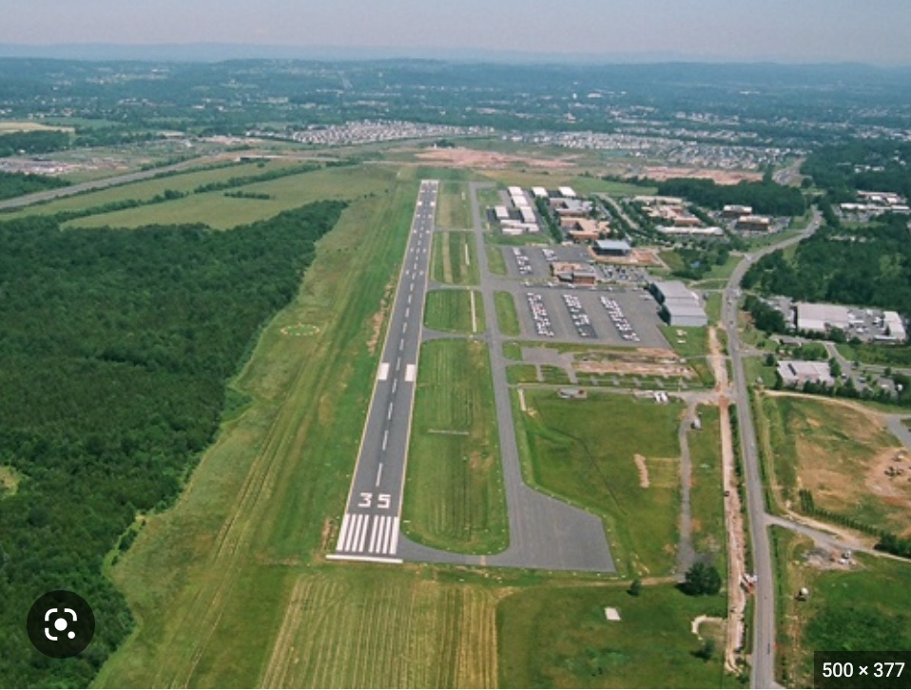
Operating in & out of Leesburg airport (jyo)

Slide 5
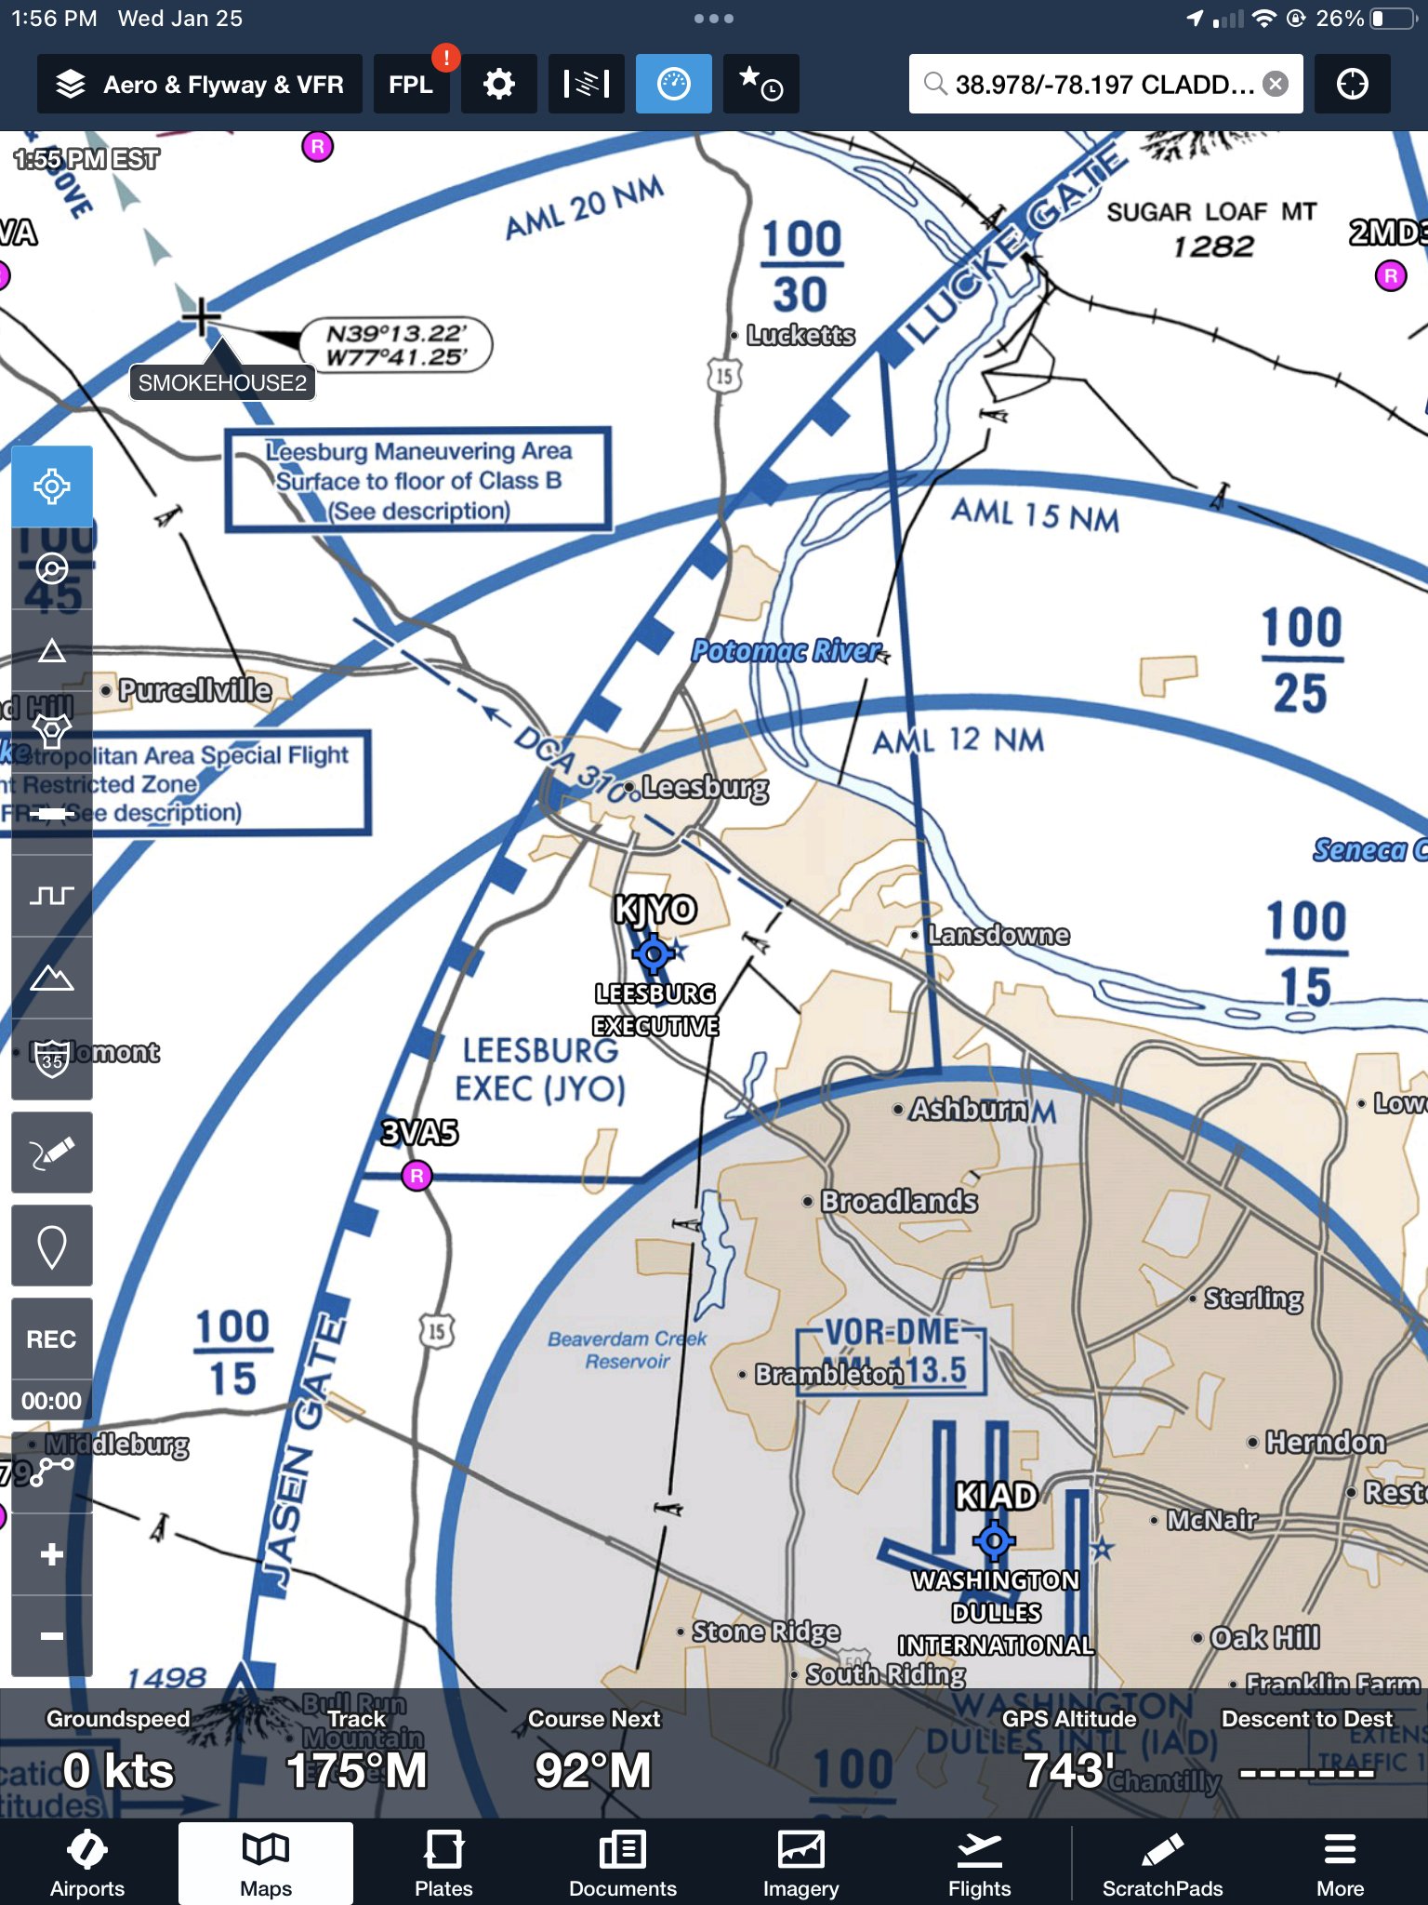
Leesburg Maneuvering Area
Foreflight Flyway Chart

Slide 6
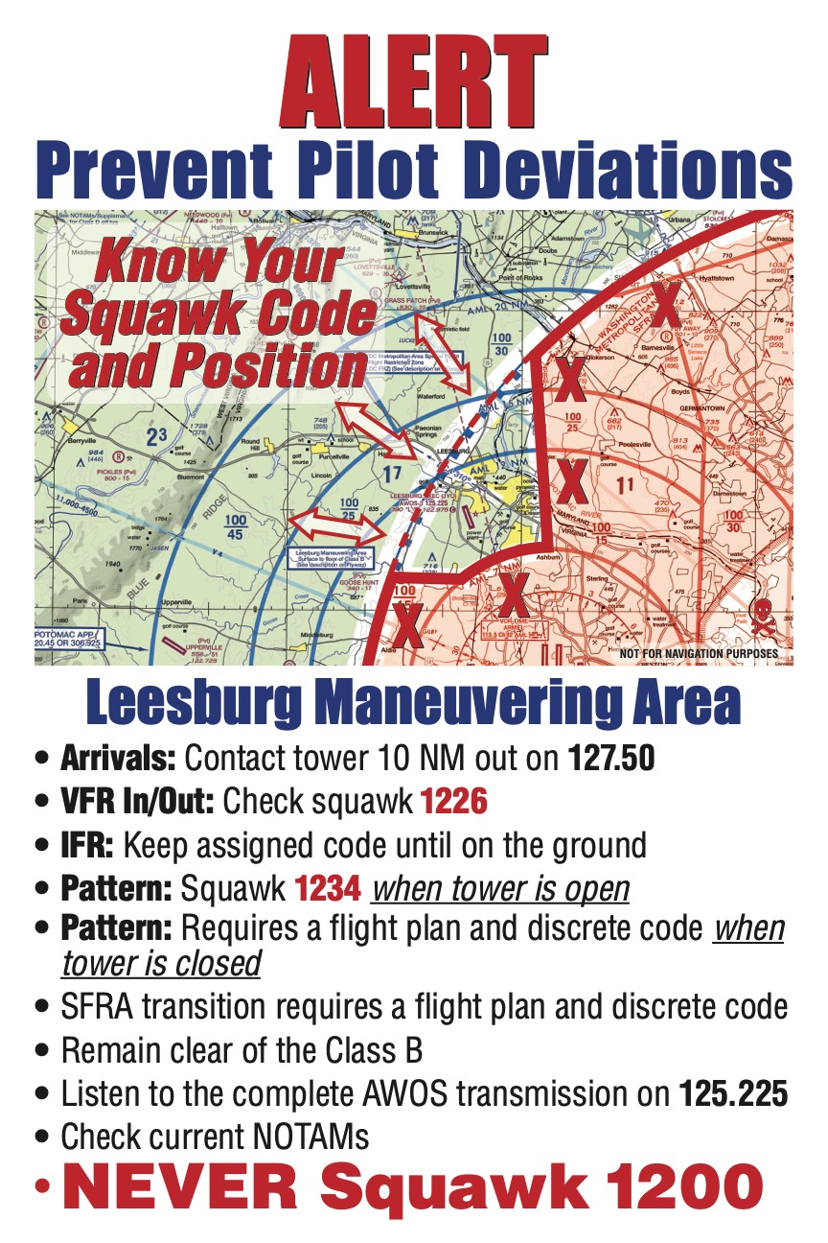

Slide 7
LMA Brief

